Slide 1
EXECUTIVE PRESENTATION
UNDERSTANDING CALL CAMPAIGN LOBs MAIN MARKET - FAIRMONEY -
SALES PIPELINE
AGENTS APPRECIATION FOR IMPROVED PERFORMANCE - Bounty –
(Reasons for my concerns)

Slide 2
Agenda of Meeting
Executive Summary
Current Performance Analysis
Feedback on the CPA
Set a Clear Goal
Prepare necessary Data.
AOB

Slide 3
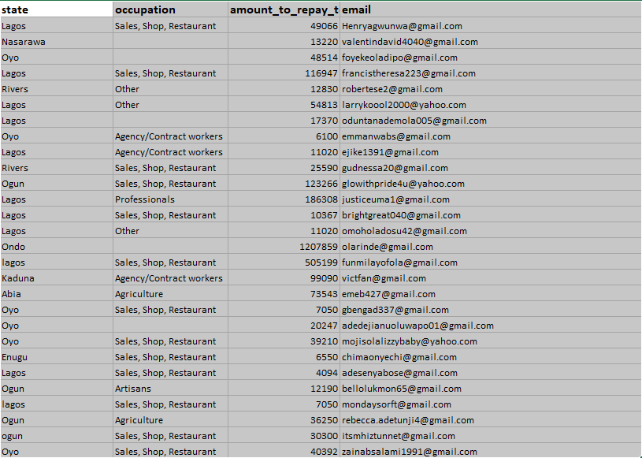
UNDERSTANDING CALL CAMPAIGN LOBs MAIN MARKET - FAIRMONEY -
1. Identify the main market
2. Strategies on reaching the main market complete in daily/weekly Create action plan and time table on how to attack the main markets
3. Follow up to see all main markets are reached in a week.
4. Possibility of revenue
5. Application to all other LOBs

Slide 4

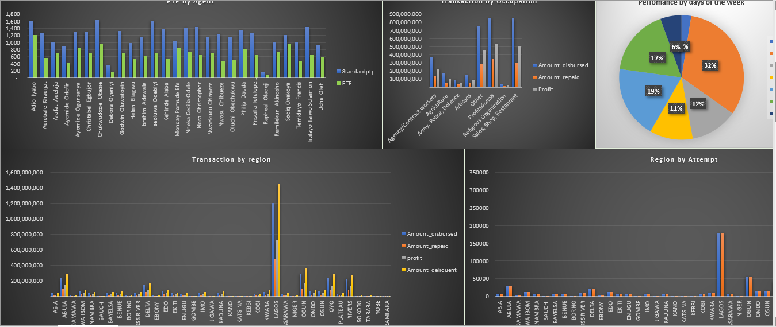
MAIN MARKETS

Slide 5
SOLUTION / ROLL-OUT (at the end of the day)
STATEMENT OF PROBLEMS
Not reaching all customers on our DB
Inability to reach the paying customers.
Data base not segmented.
Poor follow-up
Inadequate using of other channels.
Inadequate targeting Customer base on amount disbursed.
DPD buckets not optimal enough
Not making enough money based on the above
Reach all customers on our DB
Distinguish more paying segment
Data base upload in segments
Certain about the customer to follow up
Inadequate using of other channels.
DPD buckets not optimal enough
Become highflier in loan recovery agency
Bonus/ Motivation Roll-out
Ranking
Bonus
Portrait
Special Seat
Breakfast for agents from 7:30 – 8:00
Provision of Picture Frame for best agent (Monthly)
Provision of special seat for best performing agent

Slide 6
REPORT OF THE STRATEGIC SESSION HELD ON THURSDAY, 16TH MARCH, 2023 The following subheads were developed from the presentation of Briggs Okiotor, Data Analyst as the underpinnings to restructure Contact Center Performance.
GO-DO’S
Make a sample analysis from January to March
Identify options for segmentation e.g., Geo location, DPD buckets, Successful/unsuccessful.
Monthly Call Analysis of the contact center
Weekly review

Slide 7
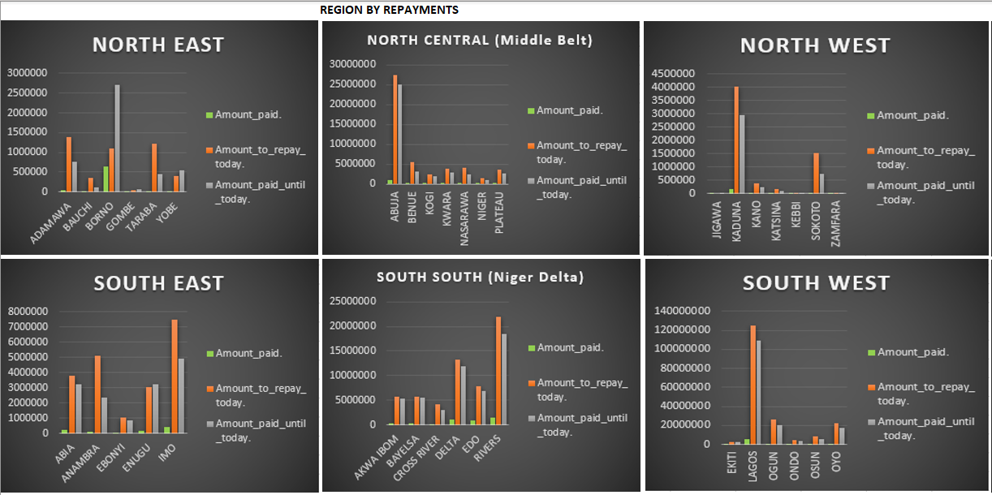
GEO Political- ZONES

Slide 8
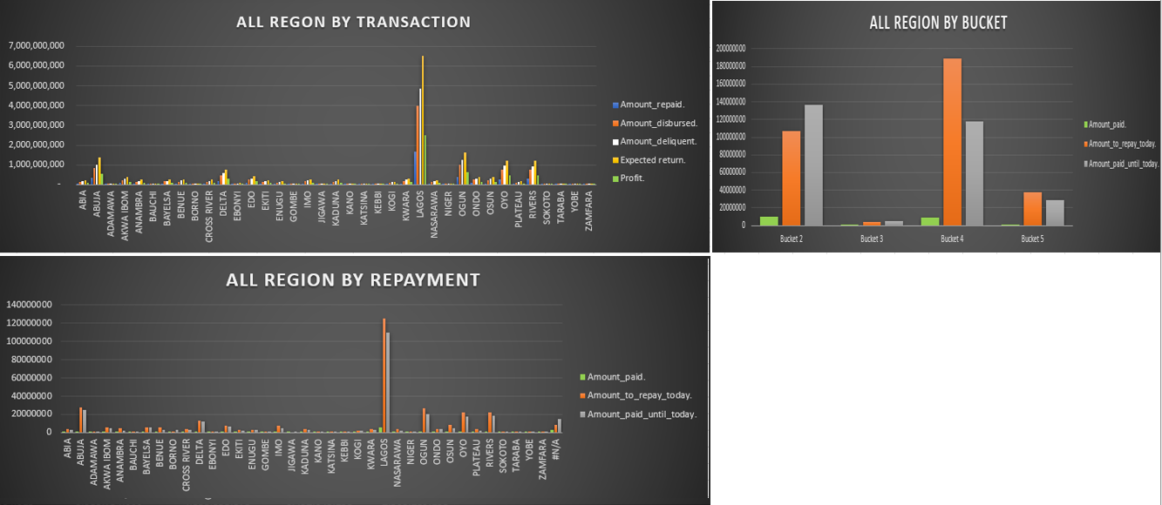
PRIORITY/ MAINMARKET

Slide 9
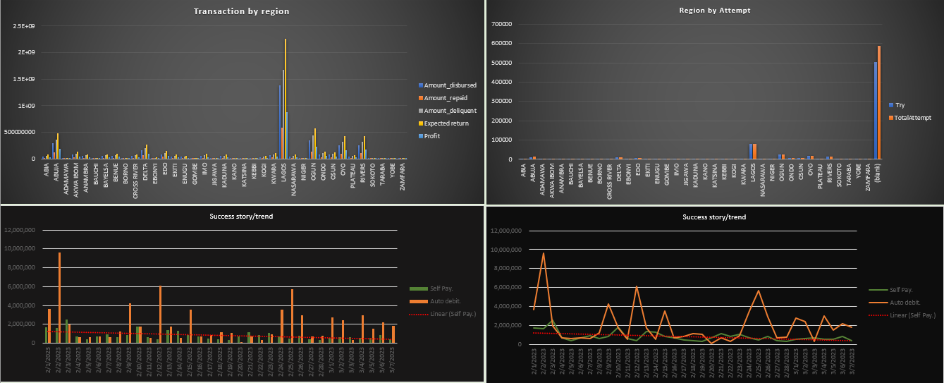
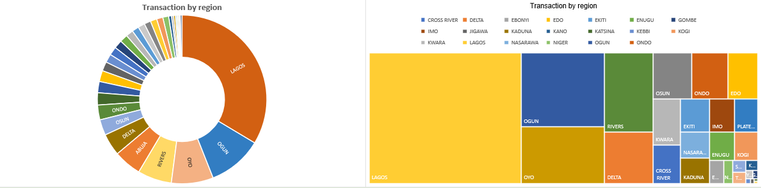

Slide 10
SOLUTION / ROLL-OUT (at the end of the day)
STATEMENT OF PROBLEMS
Not reaching all customers on our DB
Inability to reach the paying customers.
Data base upload not segmented.
Poor follow-up
Inadequate using of other channels.
Inadequate targeting Customer base on amount disbursed.
DPD buckets not optimal enough
Not making enough money based on the above
Reach all customers on our DB
Distinguish more paying segment
Data base upload in segments
Certain about the customer to follow up more
Using of other channels.
Bulk Emaling
WhatsApping
CRM Smsing or Bulk smsing
6. DPD buckets inside various segmentation
7. Bonus/ Motivation Roll-out
Ranking
Bonus
Portrait
Special Seat
Breakfast for agents from 7:30 – 8:00
Provision of Picture Frame for best agent (Monthly)
Provision of special seat for best performing agent

Slide 11
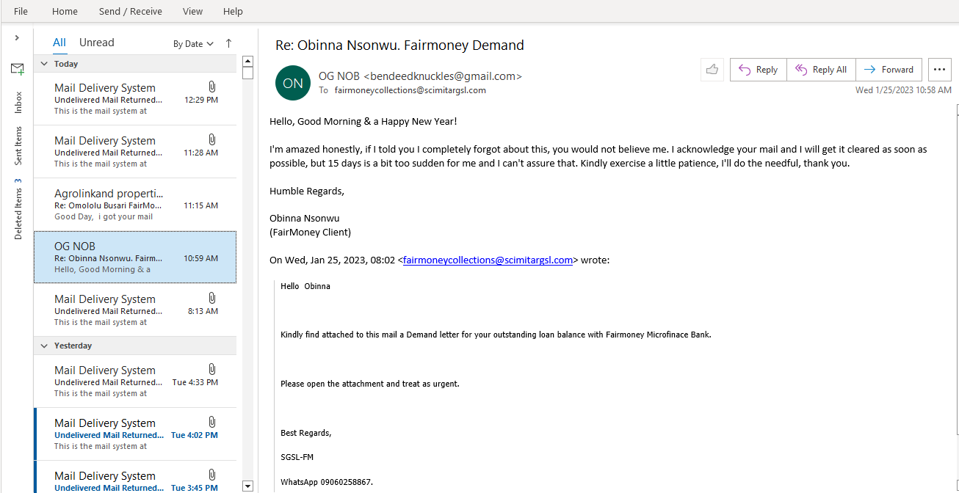
PROOF

Slide 12
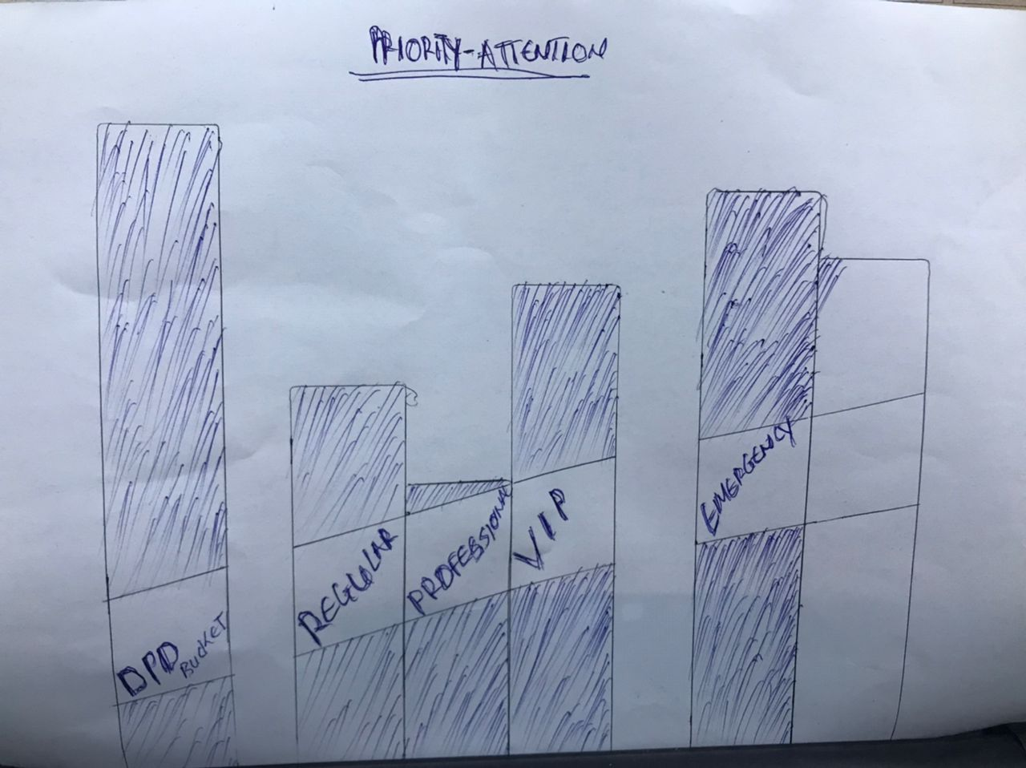
PRIORITY/ ATTENTION

Slide 13
Ultimate Resolution
REACH ALL OUR CONTACT (call base)
IDENTIFY OUR PAYING MARKET/SEGMENT
SURVIVAL OF THE FITTEST AMONGST CALL AGENTS
RANK ONE OF BEST IN LOAN RECOVERY AGENCY

Slide 14
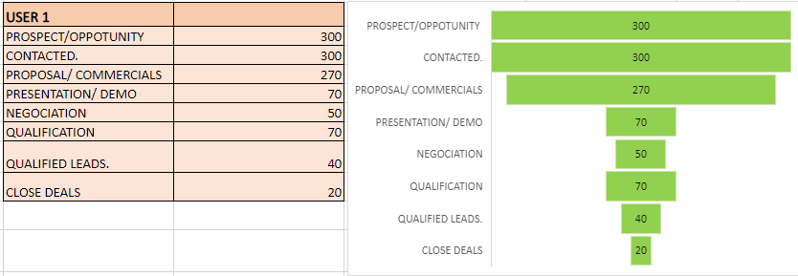
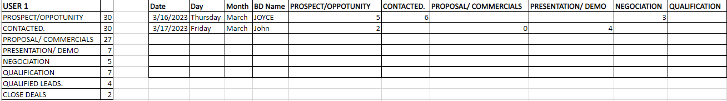
SALES PIPELINE
.1 Dashboard
2. Users inputs
3. Restrictions

